Slide 1
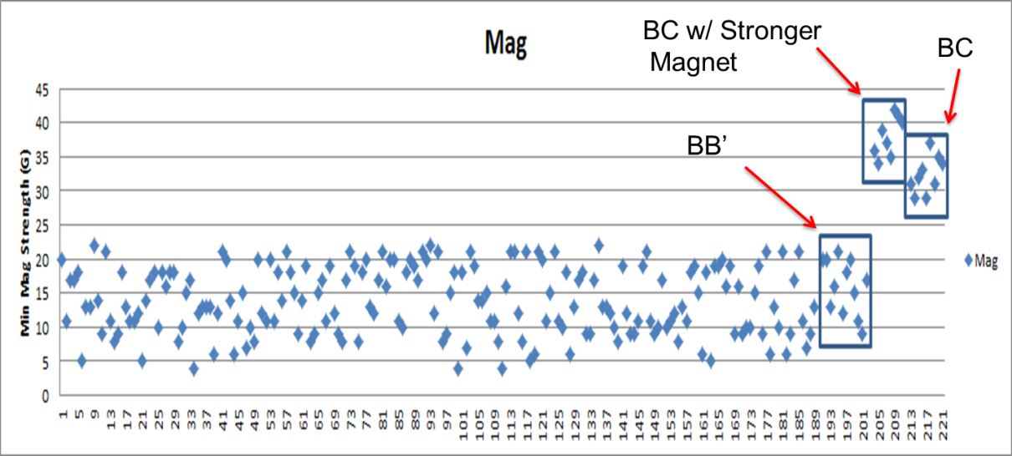
SGMW 200 Digital Position Sensor
Enhancements for Next Build (Week of April 14)
Allegro BC Chip – Significant Enhancement (Refer below)
Software update (dll & software release) …. Averaging
Probe Housing Shift of 1.0 mm (Location of Hall to Magnet)
100 samples for the SGMW 200 Handwheel Position sensor using the new plastic housings along with the new Allegro chips were measured in Suzhou this week and demonstrated a 2x improvement in the Gauss level as expected. The new software updates (dll & software release) has also been implemented which will reduce our error by 50 % for the builds that will take place later this week.
In the chart below, the first ~190 points are from the sorting that was done in China (BB'). The first box are from the post DV testing (BB'). The second box is from the BC 1332s with the Max Baermann higher strength magnets (~50% increase) on the lower rotor assemblies. The third box is from the BC 1332s with the standard production lower rotor magnets.

